Slide 1
Adham Ashraf Saeed
Assignment 4 (SQL)

Slide 2
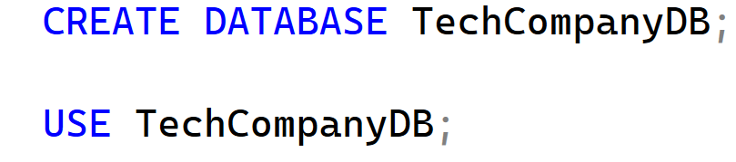
Load the provided dataset into your database
Open the provided links and download the dataset files
Items
Company
Employees
Departments

Slide 3
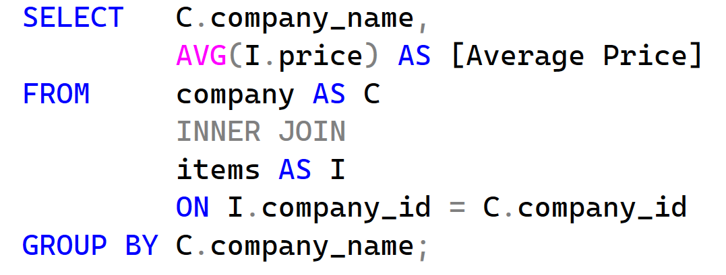
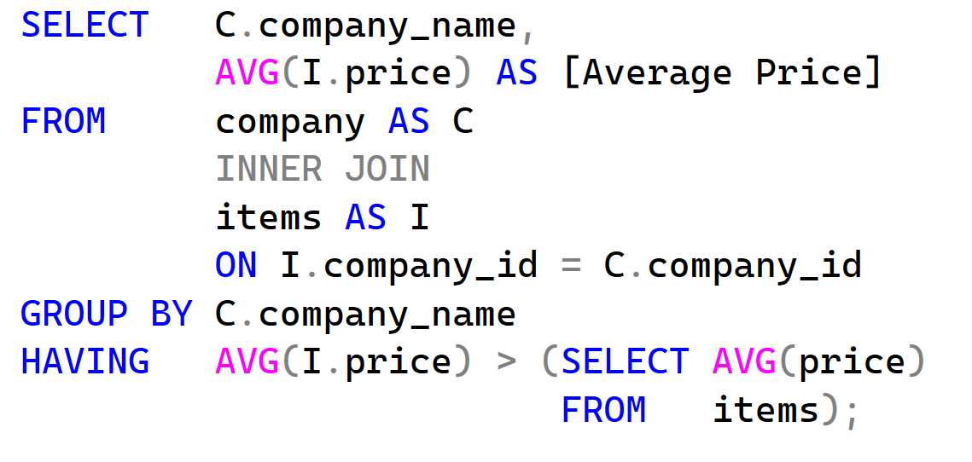
Questions
From the following tables, write a SQL query to calculate the average price of each company’s products along with the company name. Return company_name and average_price.
Write a SQL query to find all companies where the average item price is greater than the overall average price of all products. Return company_name and average_price.

Slide 4
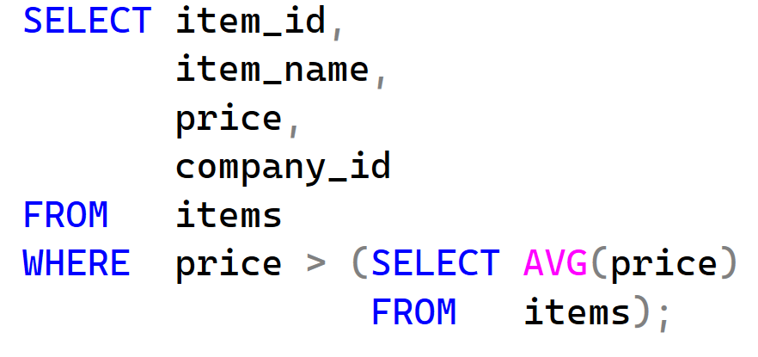
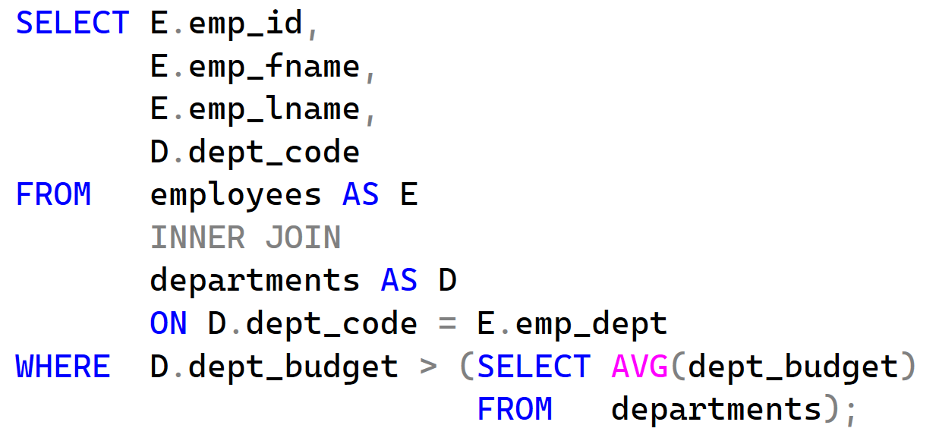
Questions
From the following tables, write a SQL query to find all items whose price is greater than the average price of all items. Return item_id, item_name, price, and company_id.
From the following tables, write a SQL query to find all employees who work in departments whose department budget is greater than the average department budget. Return emp_id, emp_fname, emp_lname, and dept_code.

Slide 5
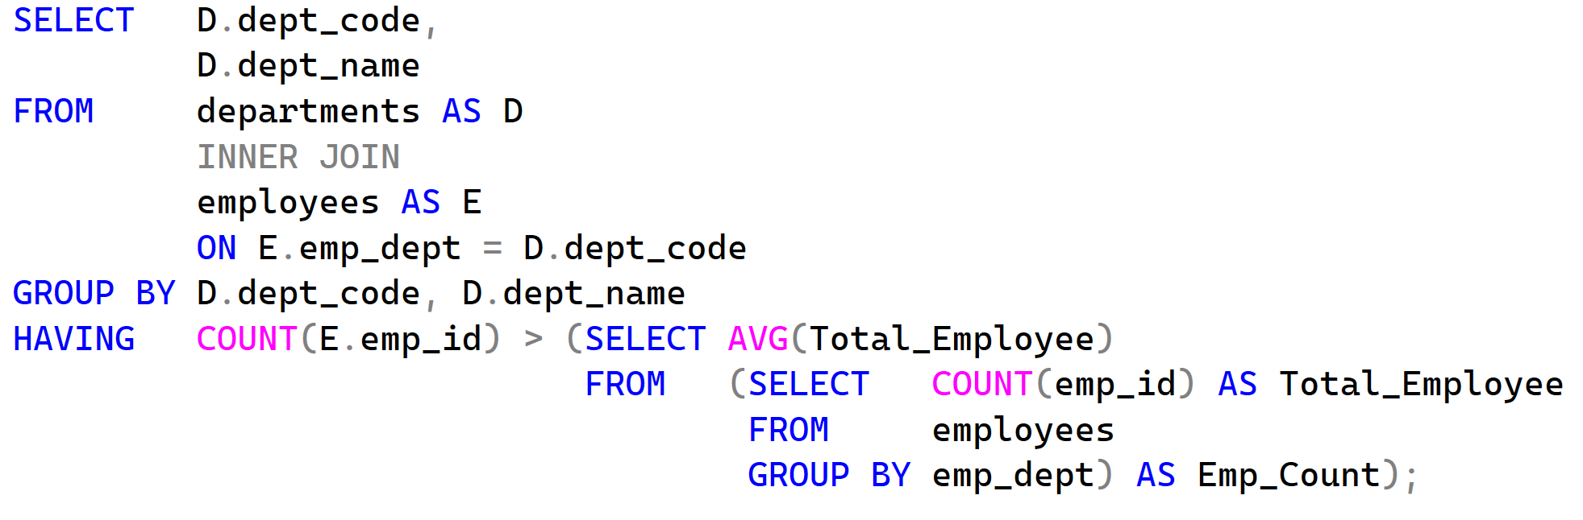
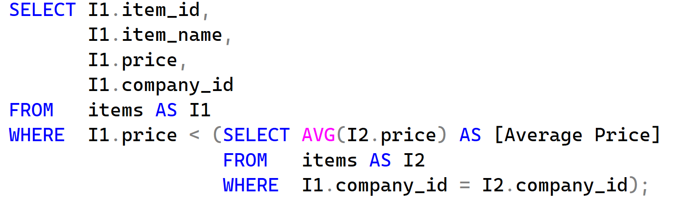
Questions
Write a SQL query to find departments which have more employees than the average number of employees per department. Return dept_code and dept_name.
From the following tables, write a SQL query to find all items whose price is less than the average price of items for the same company. Return item_id, item_name, price, and company_id.

Slide 6
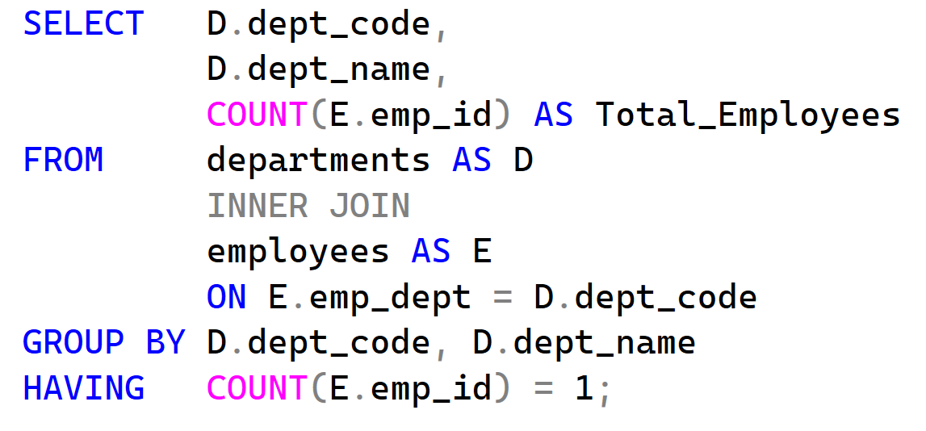
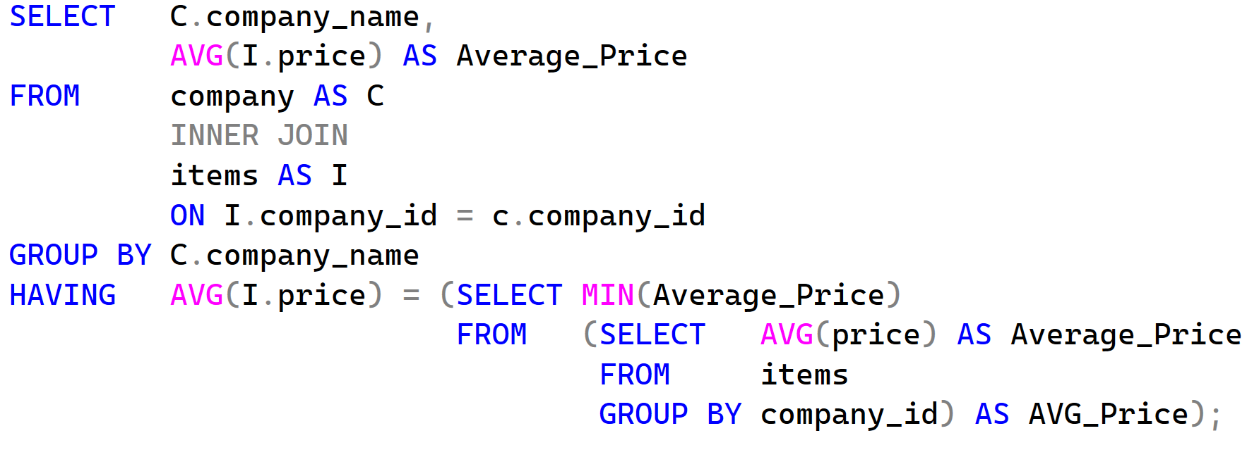
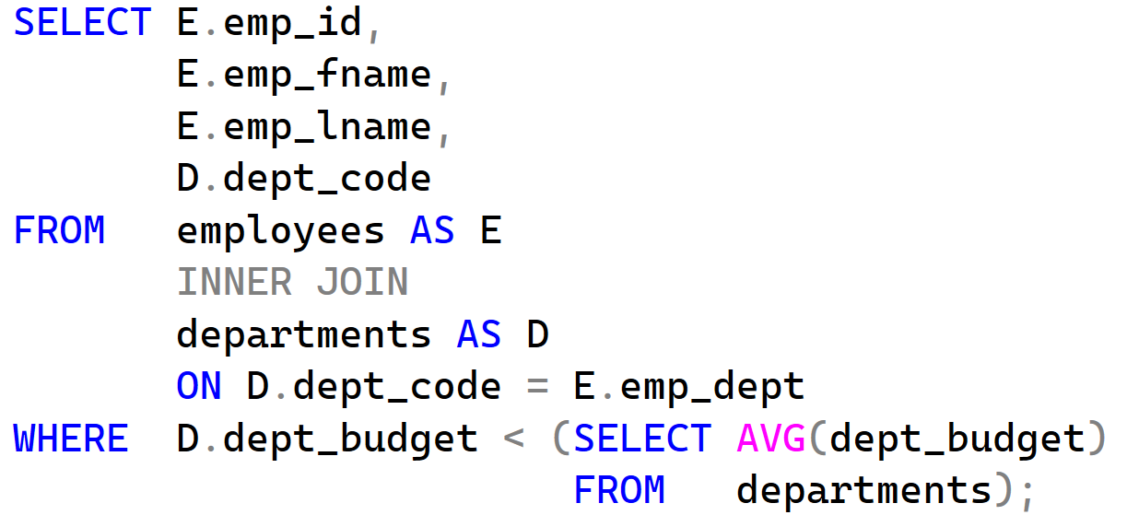
Questions
Write a SQL query to find departments that have only one employee assigned to them. Return dept_code, dept_name, and the count of employees.
From the following tables, write a SQL query to find companies whose average item price is equal to the minimum average price among all companies. Return company_name and average_price.
Write a SQL query to find employees whose department budget is less than the average department budget. Return emp_id, emp_fname, emp_lname, and dept_code.

Slide 7
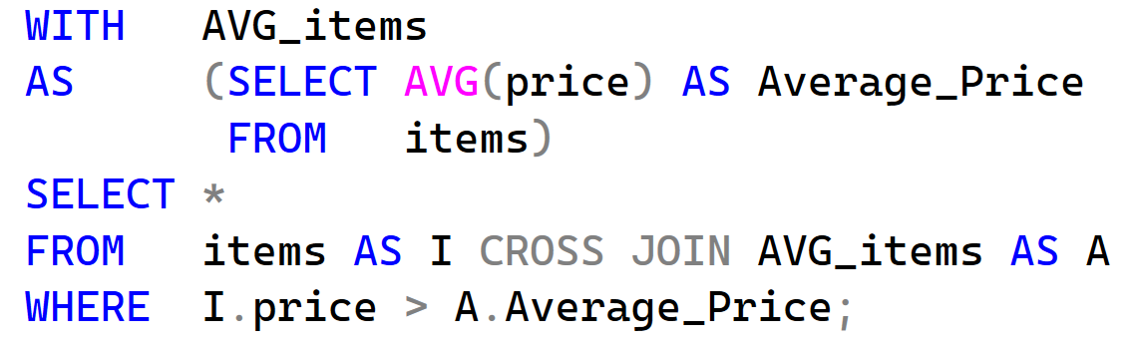
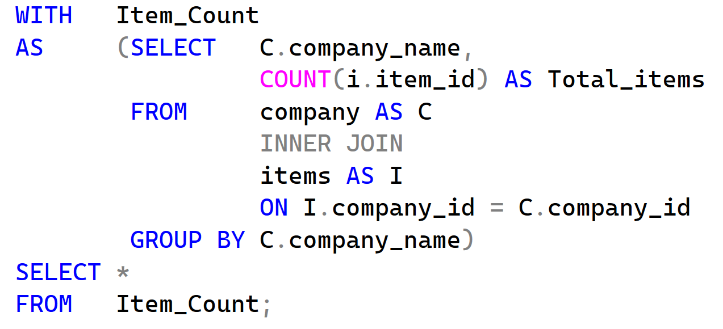
Questions
Create a CTE that calculates the average item price, then display all items whose price is greater than the average.
Create a CTE that calculates the total number of items per company, then display company name and item count.

Slide 8
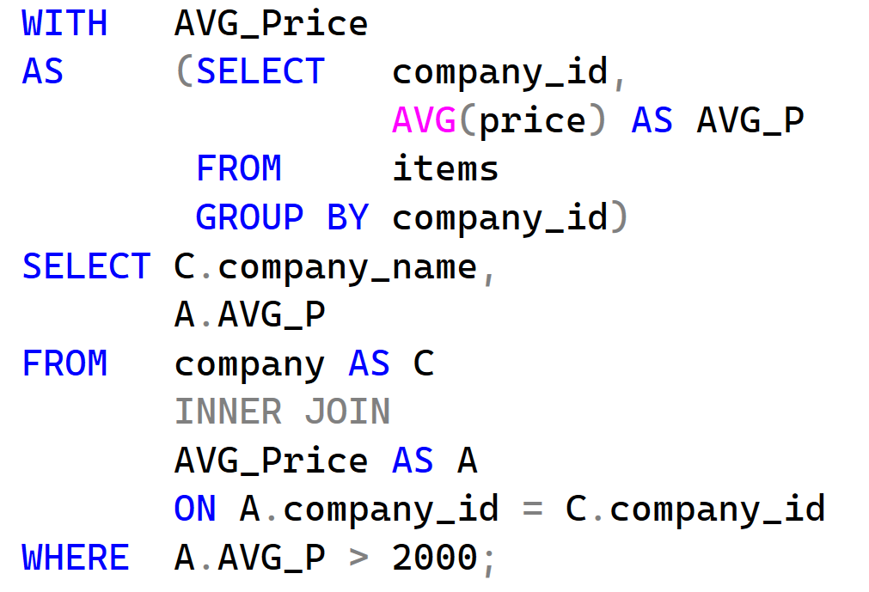
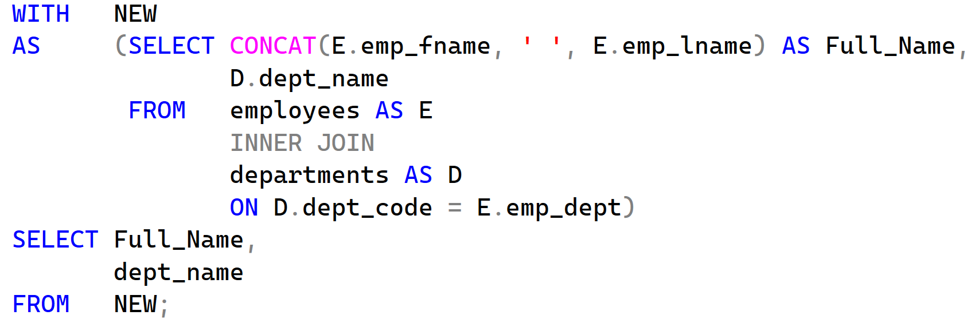
Questions
Using a CTE, calculate the average price per company, then display companies where the average price is greater than 2000.
Create a CTE that joins employees_new and departments_new to display employee full name and department name.

Slide 9
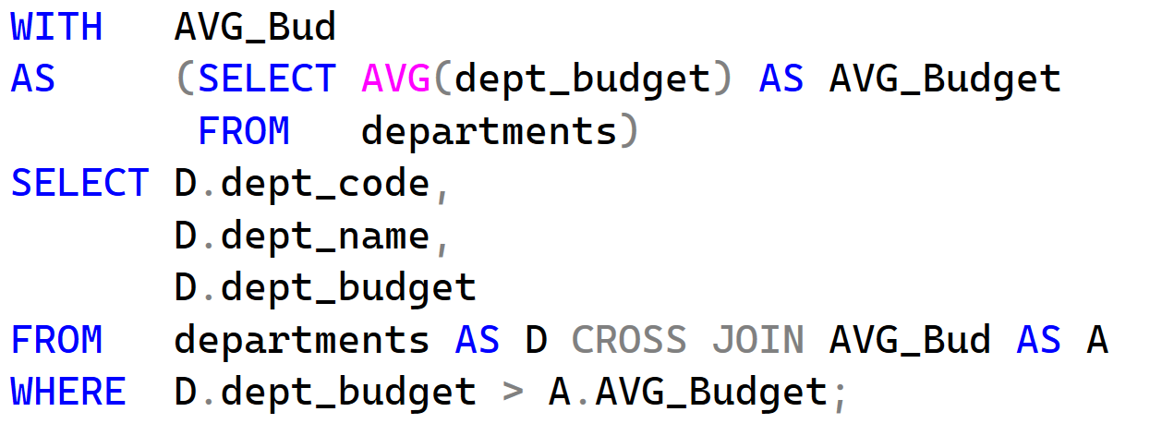
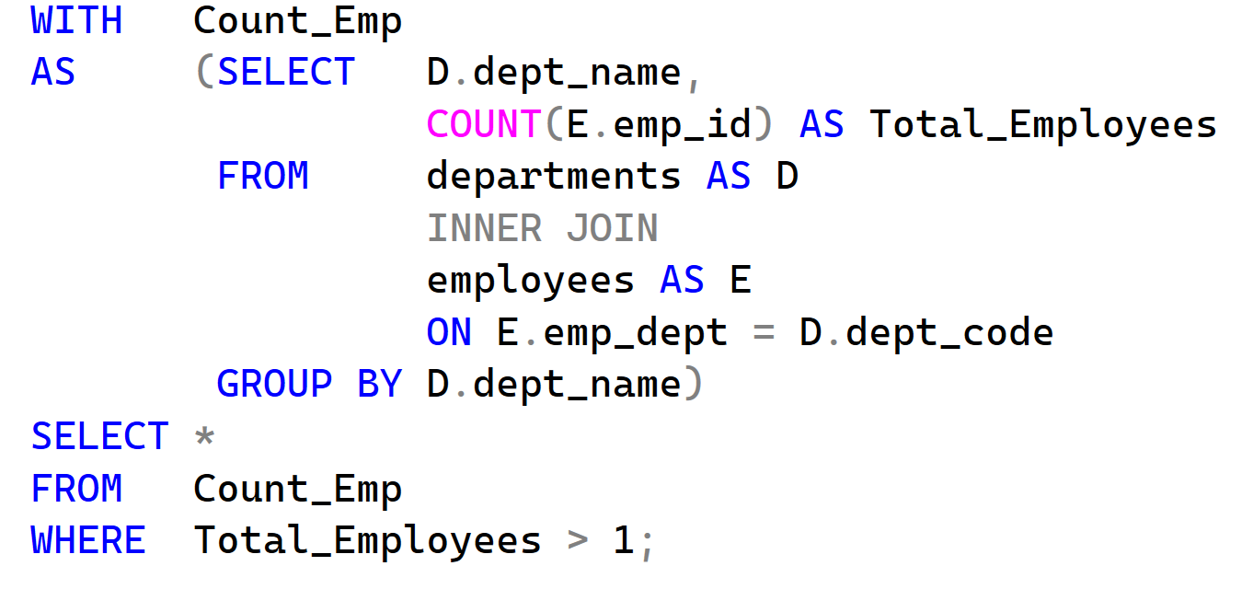
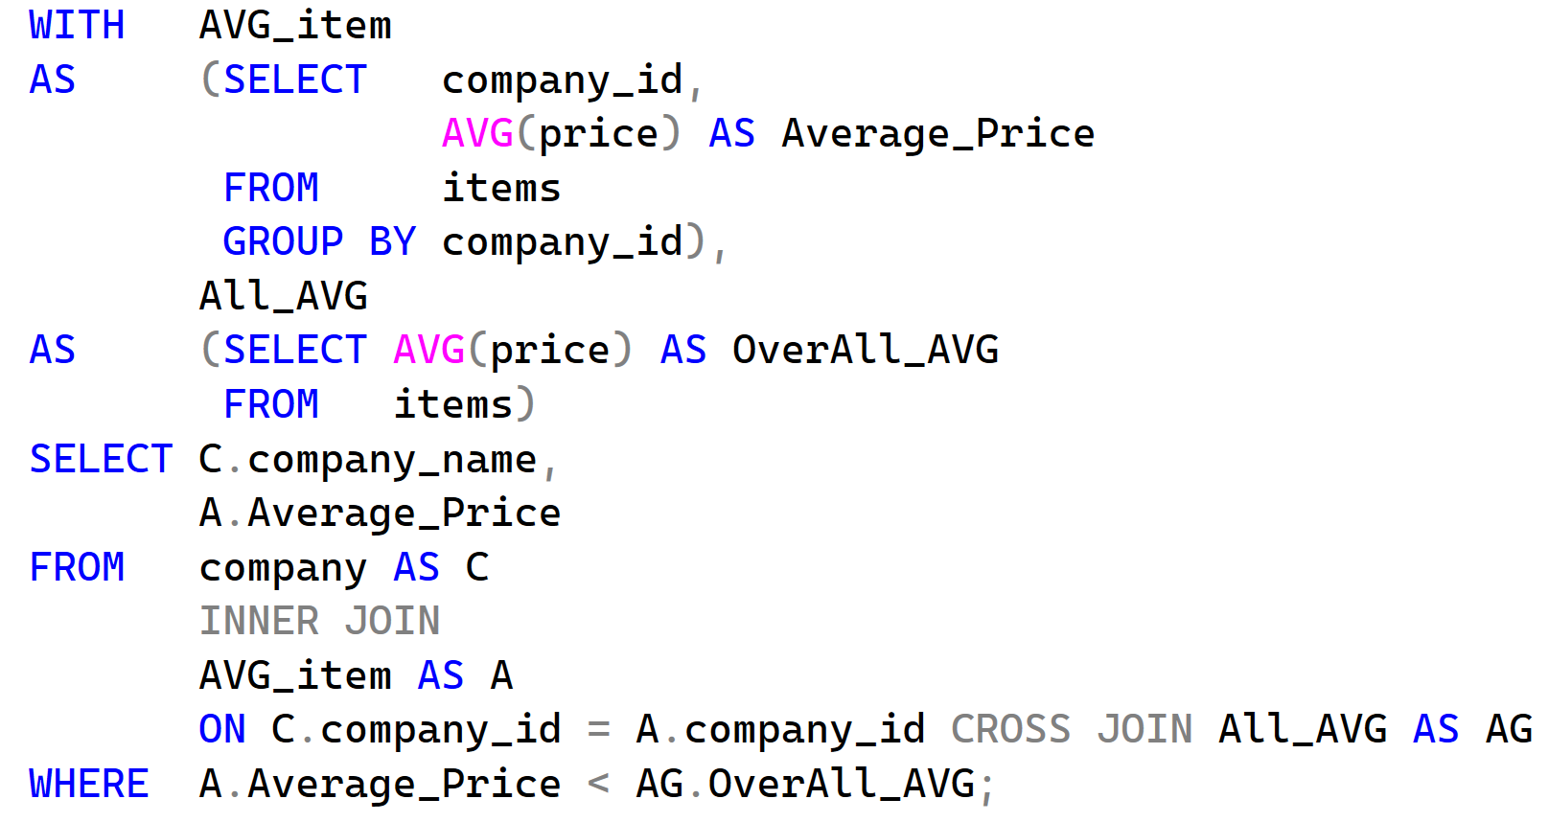
Questions
Using a CTE, find departments where the department budget is greater than the average budget.
Create a CTE that calculates the number of employees per department, then display departments that have more than one employee.
Create a CTE that calculates the average item price across all companies, then display companies whose average item price is below the overall average.

